Slide 1
Clock Synchronization and Logical Clocks

Slide 2
Lack of Global Time in Distributed Systems
It is impossible to guarantee that physical clocks run at the same frequency
Lack of global time, can cause problems
Example: UNIX make
Edit output.c at a client
output.o is at a server (compile at server)
Client machine clock can be lagging behind the server machine clock

Slide 3
UNIX Make
UNIX make command is used to compile source code
Typically, a large UNIX program is split in several files
A change to one source file only requires that file to be recompiled
Make goes through all the source files to find out which ones need to be recompiled
It examines the time in which source and object files were last modified
If the source file was last modified after the object file, make calls the compiler to recompile it

Slide 4
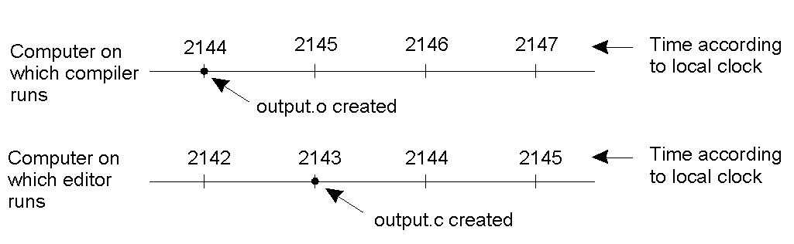
Let's suppose to have editor and compiler running on two different machines, with no global agreement on time
Suppose that output.o has time 2144, and shortly later
output.c is modified but is assigned time 2143 because the
clock on that machine is slower
Make will not call the compiler
The executable program will contain a mixture of code that probably will lead to an unpredictable behavior
Lack of synchronization is dramatic!

Slide 5
Physical Clocks
Universal Coordinated Time (UTC) is broadcast by National Institute of Standards and Technology (NIST) from Fort Collins, Colorado over shortwave radio station. It broadcasts a short pulses at the start of each UTC second. [accuracy 10 msec.]
GEOS (Geostationary Environment Operational Satellite) also offer UTC service. [accuracy 0.5 msec.]

Slide 6
Physical Clock Synchronization
External: synchronize with an external resource, UTC source
|S(t) – C_{i}(t)| < D
Internal: synchronize without access to an external resource
|C_{i}(t) – C_{j}(t)| < D

Slide 7
Clock Synchronization Algorithms
Centralized Algorithms
Cristian’s Algorithm
Berkeley Algorithm
Decentralized Algorithms
Averaging Algorithms (e.g., NTP)
Multiple External Time Sources

Slide 8
Cristian’s Algorithm – External Synch
External source S
Denote clock value at process X by C(X)
Periodically, a process P:
send message to S, requesting time
Receive message from S, containing time C(S)
Adjust C at P, should we set C(P) = C(S)?
Reply takes time
When P adjusts C(P) to C(S),
current actual C(S) > C(P)

Slide 9
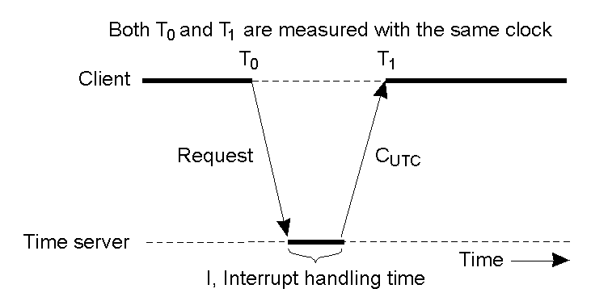
Cristian's Algorithm
Getting the current time from a time server

Slide 10
Cristian’s algorithm
Measure actual round-trip time d = T₁ – T₀
Sender’s time was T between T₀ and T₁
Receiver sets time to T + d/2
Synchronization error is at most d/2
Can retry until we get a relatively small d
Only suitable for deterministic LAN environment of Intranet

Slide 11
The Berkeley algorithm
Master uses Cristian’s algorithm to get time from many clients
Computes average time
Can discard outliers
Sends time adjustments back to all clients

Slide 12
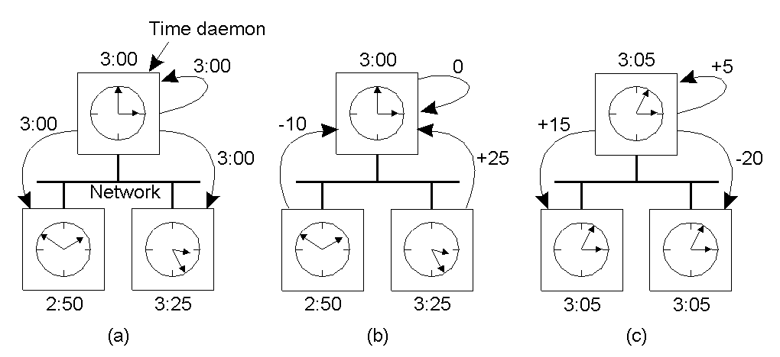
The Berkeley Algorithm
The time daemon asks all the other machines for their clock values.
The machines answer and the time daemon computes the average.
The time daemon tells everyone how to adjust their clock.

Slide 13
Averaging Algorithms
Both Cristian’s and Berkeley’s methods are highly centralized, with the usual disadvantages - single point of failure, congestion around the server, … etc.
Every R seconds, each machine broadcasts its current time.
The local machine collects all other broadcast time samples during some time interval, S.
The simple algorithm: the new local time is set as the average of the value received from all other machines.

Slide 14
Averaging Algorithms
A slightly more sophisticated algorithm: Discard the m highest and m lowest to reduce the effect of a set of faulty clocks.
Another improved algorithm: Correct each message by adding to the received time an estimate of the propagation time from the i^{th} source.
extra probe messages are needed to use this scheme.
One of the most widely used algorithms on the Internet is the Network Time Protocol (NTP).
Achieves worldwide accuracy in the range of 1-50 msec.

Slide 15
The Network Time Protocol (NTP)
Cristian’s and Berkeley algorithms → synch within intranet
NTP – defines an architecture for a time service and a protocol to distribute time information over the Internet
Synchronization similar to Cristian’s algorithm.
Modified to use multiple one-way messages instead of immediate round-trip
Uses a network of time servers to synchronize all processes on a network.
Accuracy: Local ~1ms, Global ~10ms

Slide 16
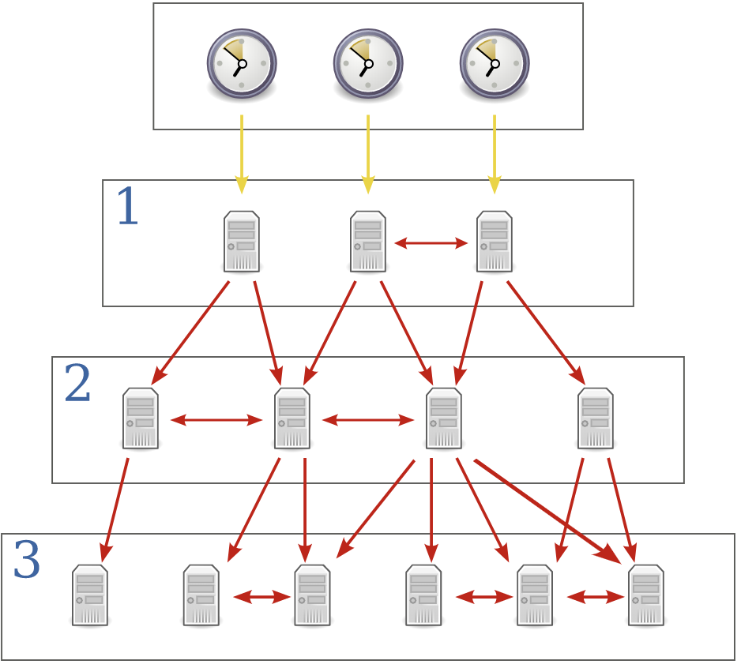
The Network Time Protocol (NTP)
Primary servers, direct synch.
Secondary servers, synched by the primary servers

Slide 17
Real synchronization is imperfect
Clocks never exactly synchronized
Often inadequate for distributed systems
might need millionth-of-a-second precision
might need totally-ordered events

Slide 18
Logical Clocks

Slide 19
Logical Clocks
For many Distributed System algorithms, associating an event to an absolute real time is not essential, we only need to know an unambiguous order of events
Lamport's timestamps
Vector timestamps

Slide 20
Logical Clocks (Cont.)
Synchronization based on “relative time”.
Example: Unix make (Is output.c updated after the generation of output.o?)
“relative time” may not relate to the “real (physical) time”.
What’s important is that the processes in the Distributed System agree on the ordering in which certain events occur.
Such “clocks” are referred to as Logical Clocks.

Slide 21
Lamport Algorithm
Clock synchronization does not have to be exact
Synchronization not needed if there is no interaction between machines
Synchronization only needed when machines communicate
i.e., must only agree on ordering of interacting events

Slide 22
Lamport’s “Happens-Before” Partial Order
Given two events e & e’, e < e’ if:
Same process: e <_{i} e’, for some process P_{i}
Same message: e = send(m) and e’=receive(m) for some message m
Transitivity: there is an event e* such that e < e* and e* < e’

Slide 23
Concurrent Events
Given two events e & e’:
If neither e < e’ nor e’< e, then e || e’ (we can also say e and e’ are concurrent).
Time
a
b
P₁
m₁
c
d
P₂
m₂
e
f
P₃
a<b<c<d<f, but we don’t know whether d<e.
Notes:
Note that if two events happen without any message, then we can't say anything about their relative occurrence in time.
In this example a < b < c < d < f, but we can say little about e other than e < f. We say that events such as a and e are concurrent.
Note also that “happens before” does not demonstrate causality. There is merely the potential for causality.

Slide 24
Lamport Logical Clocks
Substitute synchronized clocks with a global ordering of events
e_{i} < e_{j} ⇒ LC(e_{i}) < LC(e_{j})
LC_{i} is a local clock: contains increasing values
each process i has own LC_{i}
Increment LC_{i} on each event occurrence
within same process i, if e_{j} occurs before e_{k}
LC_{i}(e_{j}) < LC_{i}(e_{k})
If e_{s} is a send event and e_{r} receives that send, then
LC_{i}(e_{s}) < LC_{j}(e_{r})

Slide 25
Lamport Algorithm
Each process increments local clock between any two successive events
Message contains a timestamp
Upon receiving a message, if received timestamp is ahead, receiver fast forward its clock to be one more than sending time

Slide 26
Lamport Algorithm (cont.)
Timestamp
Each event is given a timestamp t
If e_{s} is a send message m from p_{i}, then t=LC_{i}(e_{s})
When p_{j} receives m, set LC_{j} value as follows
If t < LC_{j}, increment LC_{j} by one
Message regarded as next event on j
If t ≥ LC_{j}, set LC_{j} to t+1

Slide 27
Lamport’s Algorithm Analysis (1)
e_{i} < e_{j} ⇒ LC(e_{i}) < LC(e_{j})
a
b
Time
P₁
1
2
m₁
c
d
g
P₂
3
4
5
m₂
e
f
P₃
1
5

Slide 28
Lamport’s Algorithm Analysis (2)
LC(e_{i}) < LC(e_{j}) ⇒ e_{i} < e_{j} ?
Limitation:
If LC(e_{i}) < LC(e_{j}), then it is not necessarily true that e_{i} < e_{j} (e.g., c and g)
If e_{i} and e_{j} are concurrent, LC(e_{i}) and LC(e_{j}) may have arbitrary values!
In other words, we really have no idea the order of occurrences of e_{i} and e_{j}, just based on LC(e_{i}) < LC(e_{j}).
a
b
Time
P₁
1
2
m₁
c
d
P₂
3
4
m₂
e
g
f
P₃
1
2
5

Slide 29
Vector Timestamps
Extend logical timestamps into a list of counters, one per process in the system
P_{i}’s clock is a vector VT_{i}[]
VT_{i}[i] = number of events P_{i} has stamped
VT_{i}[j] = what P_{i} thinks number of events P_{j} has stamped (i ≠ j)

Slide 30
Vector Timestamps (cont.)
Initialization
the vector timestamp for each process is initialized to (0,0,…,0)
Local event
when an event occurs on process P_{i}, VT_{i}[i] ← VT_{i}[i] + 1
e.g., on process 3, (1,2,1,3) → (1,2,2,3)

Slide 31
Vector Timestamps (cont.)
Message passing
when P_{i} sends a message to P_{j}, the message has timestamp t[]=VT_{i}[]
when P_{j} receives the message, it sets VT_{j}[k] to max (VT_{j}[k],t[k]), for k = 1, 2, …, N, except its own clock VT_{j}[j] (its own clock VT_{j}[j] will be increased by 1 because this message receiving is a new event for P_{j})
e.g., P₂ receives a message with timestamp (3,2,4) and P₂’s timestamp is (3,3,3), then P₂ adjusts its timestamp to (3,4,4). Here P₂’s own clock is increased from 3 to 4, because for P₂, this is a new event.

Slide 32
Comparing Vectors
VT₁ = VT₂ iff VT₁[i] = VT₂[i] for all i
VT₁ ≤ VT₂ iff VT₁[i] ≤ VT₂[i] for all i
VT₁ < VT₂ iff VT₁ ≤ VT₂ & VT₁ ≠ VT₂
for instance, (1, 2, 2) < (1, 3, 2)
Notice that not all VT’s are “comparable” under this rule: consider [4,0,0] and [0,0,4]
If VT’s are not comparable, the corresponding events are concurrent

Slide 33
Vector Timestamp Analysis
Claim: e < e’ iff e.VT < e’.VT
a
b
[2,0,0]
Time
P₁
[1,0,0]
m₁
c
d
[2,2,0]
P₂
[2,1,0]
m₂
e
g
f
[2,2,3]
P₃
[0,0,1]
[0,0,2]
Examples:
Compare events a and f: [1,0,0] < [2,2,3], so a<f.
Compare events c and g: [2,1,0] is not larger nor smaller than [0,0,2], so we can say c and g are concurrent.

